Slide 1
Solimpeks Solar Energy Corp.
Fevzi Çakmak Mah. Ankara Cad. 10753 Sk. No:3 Karatay / Konya / TURKEY Tel: +90.444.06.02
Fax: +90.444.06.08
www.solimpeks.com
info@solimpeks.com
Flat - Roof
Mounting Kit
Manual
For 2,1 sqm Vertical Collector

Slide 2
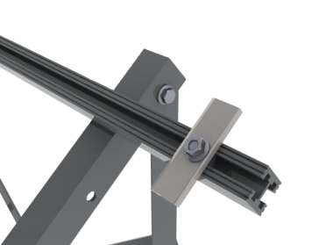
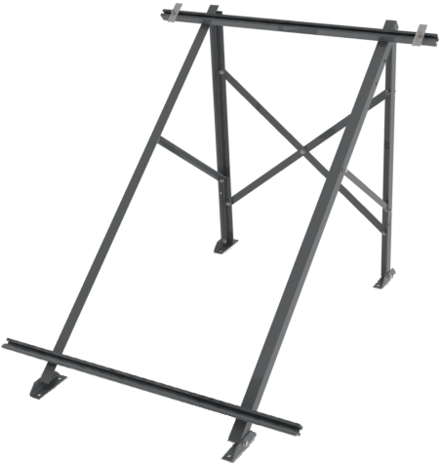
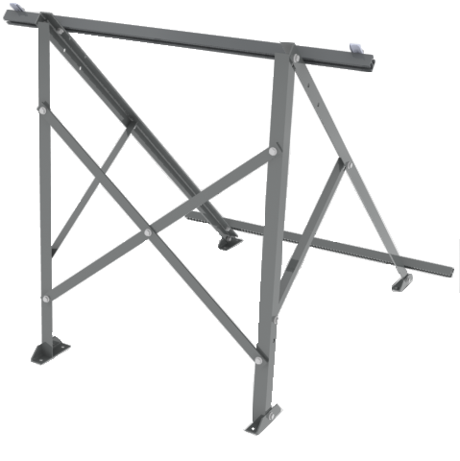
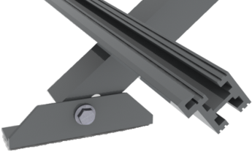
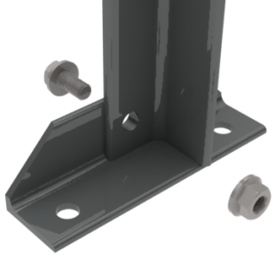
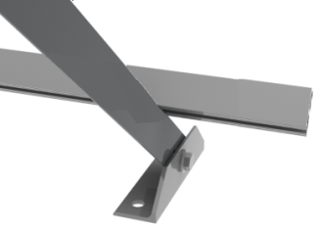
1 Collector 2108
No | Unit | Dimensions
1L | 1 | 1620 X 30 X 30 mm
 | 1 | 1040 X 30 X 30 mm
 | 1 | 590 X 25 X 25 mm
1R | 1 | 1620 X 30 X 30 mm
 | 1 | 1040 X 30 X 30 mm
 | 1 | 590 X 25 X 25 mm
3R | 1 | 2 screwed pieces of 980 X 30 X 5 mm
5U | 1 | 1150 X 30 X 30 mm
5D | 1 | 1150 X 30 X 30 mm
Screw | 21 | M10 X 20
Nut | 21 | M10
Clamp | 2 | 90 X 30
Mounting Shoe | 4 | 150 X 40 X 40
5U
1L
Clamp
5D
1R
Mounting Shoe
3R
Screw
Mounting hole
Nut

